Slide 1


AIChE 2019 Computational Catalysis Workshop: Thermochemistry
Jonathan Lym, Gerhard Wittreich, Bharat Medasani, Dionisios Vlachos

Slide 2
Multiscale Modeling
Process and plant simulation
Computational fluid dynamics (CFD)
Microkinetic Modeling
Kinetic Monte Carlo (kMC)
Course-grained kMC
Length Scale
Molecular dynamics (MD)
Accelerated MD
Quantum Mechanics
Transition State Theory
Time Scale
[1] Salciccioli, M. et al. Chem. Eng. Sci. 2011, 66 (19), 4319–4355.

Slide 3
Multiscale Modeling
Process and plant simulation
Computational fluid dynamics (CFD)
Bottom-up info traffic
Microkinetic Modeling
Kinetic Monte Carlo (kMC)
Course-grained kMC
Length Scale
Molecular dynamics (MD)
Accelerated MD
Top-down info traffic
Quantum Mechanics
Transition State Theory
Time Scale
[1] Salciccioli, M. et al. Chem. Eng. Sci. 2011, 66 (19), 4319–4355.

Slide 4
Microkinetic Model Inputs: Reactor Conditions
Legend
Set by user
Calculated by MKM
Derived from DFT
i – Species i
j – Reaction j

Slide 5
Microkinetic Model Inputs: Reactor Conditions
Reactor (e.g. Batch, CSTR, PFR)
Q = 1 mL s⁻¹
Inlet composition, x₀:
N₂
H₂
Inert
T = 673 K
P = 100 bar
V = 1 cm³
m_{cat} = 0.1 g Ru/Al₂O₃ catalyst
Legend
Set by user
Calculated by MKM
Derived from DFT
i – Species i
j – Reaction j

Slide 6
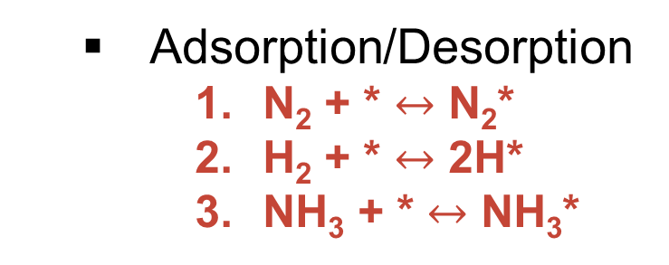
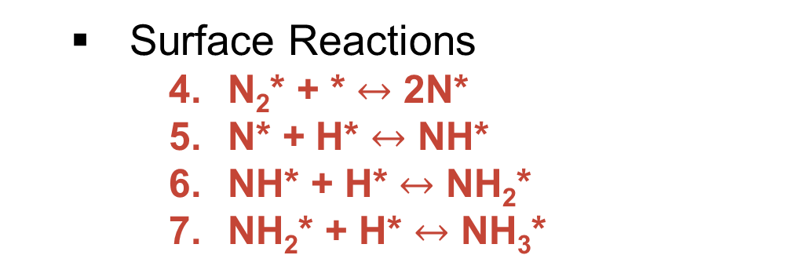
Microkinetic Model Inputs: Elementary Steps
Reactor (e.g. Batch, CSTR, PFR)
Q = 1 mL s⁻¹
Inlet composition, x₀:
N₂
H₂
Inert
T = 673 K
P = 100 bar
V = 1 cm³
m_{cat} = 0.1 g Ru/Al₂O₃ catalyst
Elementary reversible reactions:
Legend
Set by user
Calculated by MKM
Derived from DFT
i – Species i
j – Reaction j
Adsorption/Desorption
N₂ + * $↔$ N₂*
H₂ + * $↔$ 2H*
NH₃ + * $↔$ NH₃*
Surface Reactions
N₂* + * $↔$ 2N*
N* + H* $↔$ NH*
NH* + H* $↔$ NH₂*
NH₂* + H* $↔$ NH₃*

Slide 7
Microkinetic Model Inputs: Mass Balance of N₂*
$$\frac{d}{dt}\left[N_{2}^{∗}\right]=k_{1}^{fwd}P_{N_{2}}[∗]−k_{1}^{rev}\left[N_{2}^{∗}\right]− k_{4}^{fwd}\left[N_{2}^{∗}\right]\left[∗\right]+k_{4}^{rev}{\left[N^{∗}\right]}^{2}$$
Elementary reversible reactions:
Legend
Set by user
Calculated by MKM
Derived from DFT
i – Species i
j – Reaction j
Adsorption/Desorption
N₂ + * $↔$ N₂*
H₂ + * $↔$ 2H*
NH₃ + * $↔$ NH₃*
Surface Reactions
N₂* + * $↔$ 2N*
N* + H* $↔$ NH*
NH* + H* $↔$ NH₂*
NH₂* + H* $↔$ NH₃*

Slide 8
Microkinetic Model Inputs: Mass Balance of N₂*
$$\frac{d}{dt}\left[N_{2}^{∗}\right]=k_{1}^{fwd}P_{N_{2}}[∗]−k_{1}^{rev}\left[N_{2}^{∗}\right]− k_{4}^{fwd}\left[N_{2}^{∗}\right]\left[∗\right]+k_{4}^{rev}{\left[N^{∗}\right]}^{2}$$
Adsorption
Surface Reactions
Elementary reversible reactions:
Legend
Set by user
Calculated by MKM
Derived from DFT
i – Species i
j – Reaction j
Adsorption/Desorption
N₂ + * $↔$ N₂*
H₂ + * $↔$ 2H*
NH₃ + * $↔$ NH₃*
Surface Reactions
N₂* + * $↔$ 2N*
N* + H* $↔$ NH*
NH* + H* $↔$ NH₂*
NH₂* + H* $↔$ NH₃*

Slide 9
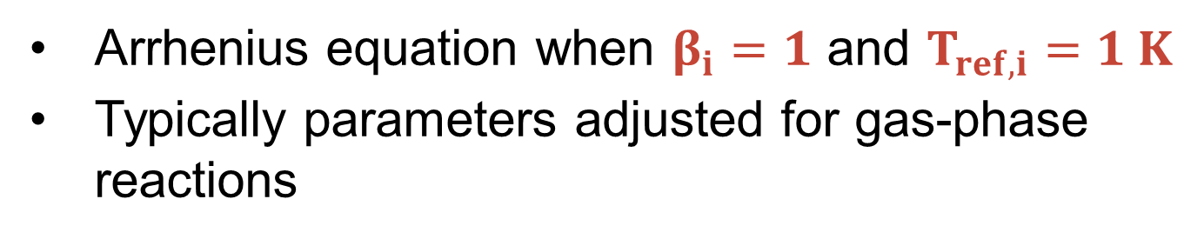
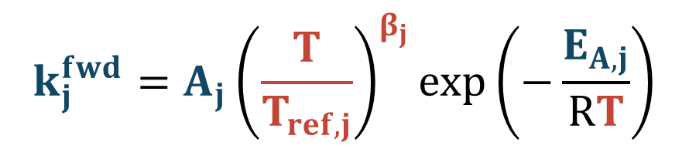
Microkinetic Model Inputs: Modified Arrhenius Rate Constants
$$\frac{d}{dt}\left[N_{2}^{∗}\right]=k_{1}^{fwd}P_{N_{2}}[∗]−k_{1}^{rev}\left[N_{2}^{∗}\right]− k_{4}^{fwd}\left[N_{2}^{∗}\right]\left[∗\right]+k_{4}^{rev}{\left[N^{∗}\right]}^{2}$$
$$k_{j}^{fwd}=A_{j}{\left(\frac{T}{T_{ref,j}}\right)}^{β_{j}}\exp\left(−\frac{E_{A,j}}{RT}\right)$$
Legend
Set by user
Calculated by MKM
Derived from DFT
i – Species i
j – Reaction j
Arrhenius equation when $β_{i}=1$ and $T_{ref,i}=1 K$
Typically parameters adjusted for gas-phase reactions

Slide 10
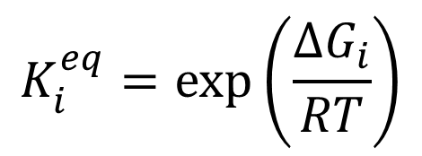

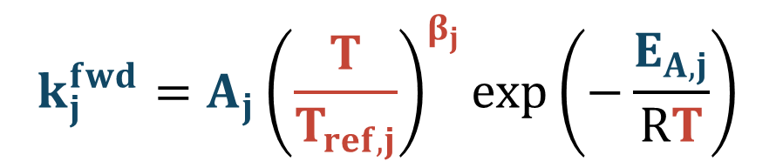
Microkinetic Model Inputs: Reverse Rate Constants
$$\frac{d}{dt}\left[N_{2}^{∗}\right]=k_{1}^{fwd}P_{N_{2}}[∗]−k_{1}^{rev}\left[N_{2}^{∗}\right]− k_{4}^{fwd}\left[N_{2}^{∗}\right]\left[∗\right]+k_{4}^{rev}{\left[N^{∗}\right]}^{2}$$
$$k_{j}^{fwd}=A_{j}{\left(\frac{T}{T_{ref,j}}\right)}^{β_{j}}\exp\left(−\frac{E_{A,j}}{RT}\right)$$
$$k_{j}^{rev}=\frac{k_{j}^{fwd}}{K_{j}^{eq}}$$
By microscopic reversibility
Legend
Set by user
Calculated by MKM
Derived from DFT
i – Species i
j – Reaction j
$$K_{i}^{eq}=\exp\left(\frac{ΔG_{i}}{RT}\right)$$

Slide 11
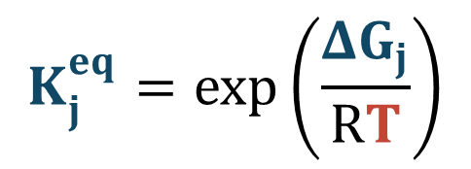
Microkinetic Model Inputs: Reverse Rate Constants
$$\frac{d}{dt}\left[N_{2}^{∗}\right]=k_{1}^{fwd}P_{N_{2}}[∗]−k_{1}^{rev}\left[N_{2}^{∗}\right]− k_{4}^{fwd}\left[N_{2}^{∗}\right]\left[∗\right]+k_{4}^{rev}{\left[N^{∗}\right]}^{2}$$
$$k_{j}^{fwd}=A_{j}{\left(\frac{T}{T_{ref,j}}\right)}^{β_{j}}\exp\left(−\frac{E_{A,j}}{RT}\right)$$
$$k_{j}^{rev}=\frac{k_{j}^{fwd}}{K_{j}^{eq}}$$
By microscopic reversibility
Legend
Set by user
Calculated by MKM
Derived from DFT
i – Species i
j – Reaction j
$$K_{j}^{eq}=\exp\left(\frac{ΔG_{j}}{RT}\right)$$

Slide 12
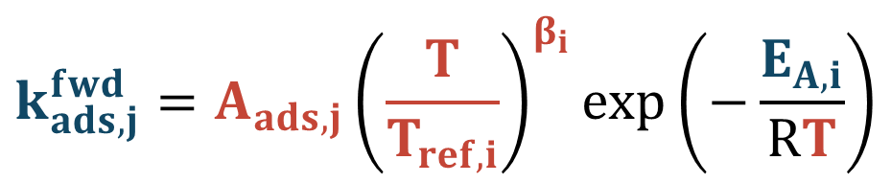
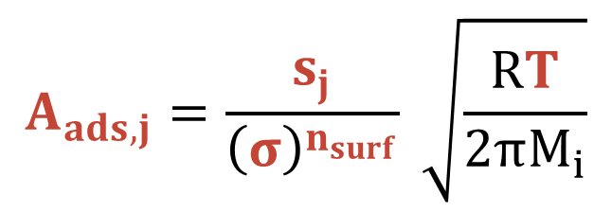
Microkinetic Model Inputs: Adsorption Preexponential Factor
$$\frac{d}{dt}\left[N_{2}^{∗}\right]=k_{1}^{fwd}P_{N_{2}}[∗]−k_{1}^{rev}\left[N_{2}^{∗}\right]− k_{4}^{fwd}\left[N_{2}^{∗}\right]\left[∗\right]+k_{4}^{rev}{\left[N^{∗}\right]}^{2}$$
$$k_{ads, j}^{fwd}=A_{ads, j}{\left(\frac{T}{T_{ref,i}}\right)}^{β_{i}}\exp\left(−\frac{E_{A,i}}{RT}\right)$$
Legend
Set by user
Calculated by MKM
Derived from DFT
i – Species i
j – Reaction j
By collision theory
$$A_{ads,j}=\frac{s_{j}}{{\left(σ\right)}^{n_{surf}}} \sqrt{\frac{RT}{2πM_{i}}}$$

Slide 13
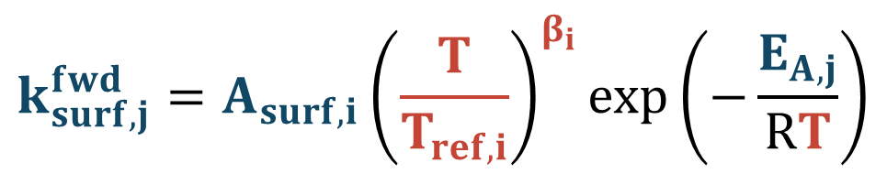

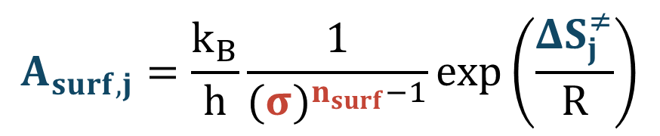
Microkinetic Model Inputs: Surface Preexponential Factor
$$\frac{d}{dt}\left[N_{2}^{∗}\right]=k_{1}^{fwd}P_{N_{2}}[∗]−k_{1}^{rev}\left[N_{2}^{∗}\right]− k_{4}^{fwd}\left[N_{2}^{∗}\right]\left[∗\right]+k_{4}^{rev}{\left[N^{∗}\right]}^{2}$$
$$k_{surf, j}^{fwd}=A_{surf,i}{\left(\frac{T}{T_{ref,i}}\right)}^{β_{i}}\exp\left(−\frac{E_{A,j}}{RT}\right)$$
Legend
Set by user
Calculated by MKM
Derived from DFT
i – Species i
j – Reaction j
By transition-state theory
$$E_{A,j}=ΔH_{j}^{≠}$$
$$A_{surf,j}=\frac{k_{B}}{h}\frac{1}{{(σ)}^{n_{surf}−1}}\exp\left(\frac{ΔS_{j}^{≠}}{R}\right)$$

Slide 14
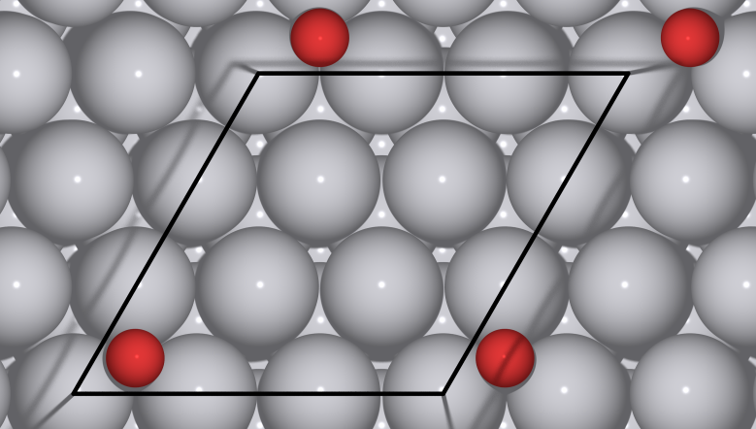
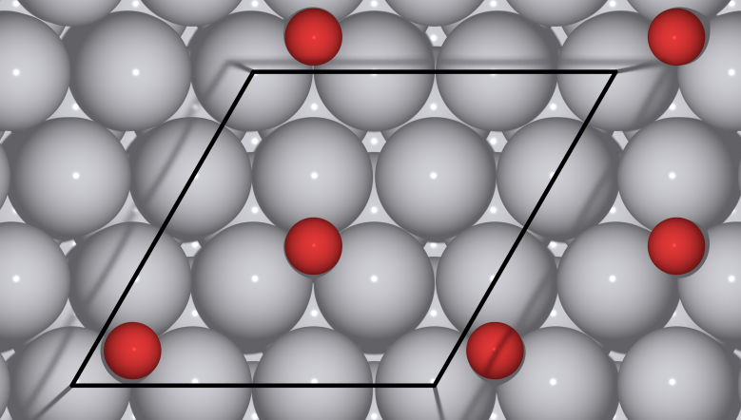
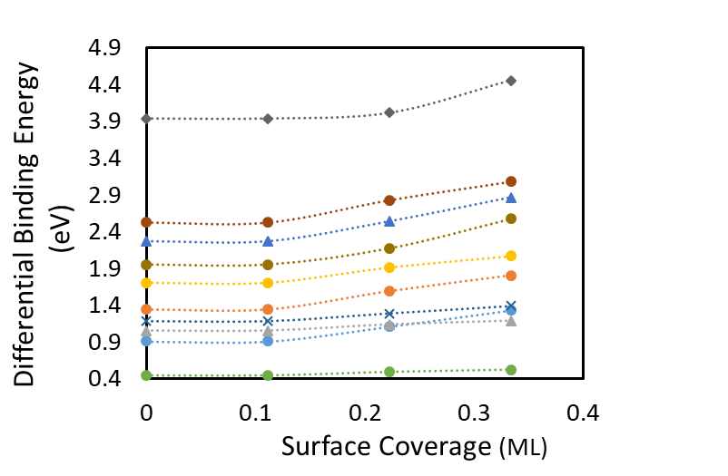
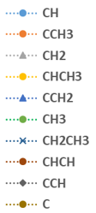
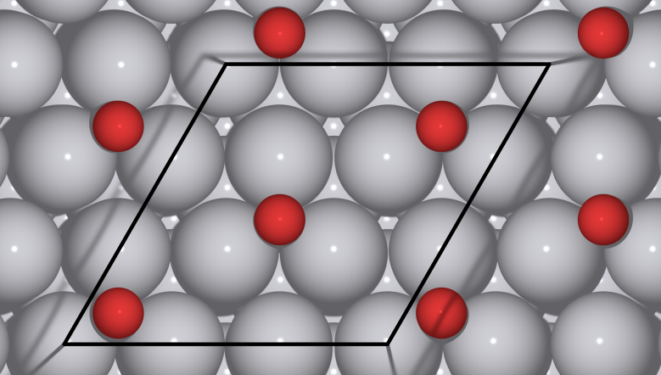
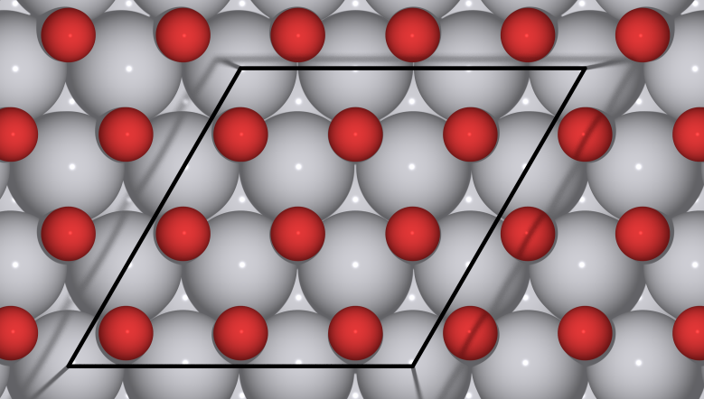

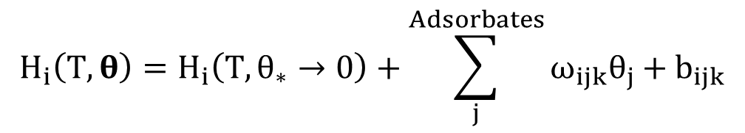



Lateral Interactions Modify Enthalpies
$$H_{i}\left(T, θ\right)=H_{i}\left(T,θ_{∗}→0\right)+\sum_{j}^{Adsorbates}{ω_{ijk}θ_{j}+b_{ijk}}$$
$$θ_{O}=\frac{1}{9} ML$$
$$θ_{O}=\frac{2}{9} ML$$
Low coverage
Finite coverage
Enthalpy of species change with coverage
Linear piece-wise is often sufficient:
$$θ_{O}=\frac{3}{9} ML$$
$$θ_{O}=1 ML$$

Slide 15
Microkinetic Model Input Summary
Set by user
Reactor conditions
T, P, Q, V, x_{i0}, m_{cat}
Elementary steps
Adsorption
Surface reactions
Reaction parameters
s_{j}, σ, T_{ref,j}, β_{j}
Calculated by MKM
Surface coverages
Gas-phase compositions
Rates
Derived from DFT
Enthalpies (H) and entropies (S) of:
Reactants
Products
Intermediates
Transition states
Coverage effects

Slide 16
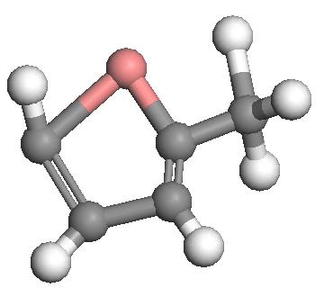

Optimizing Intermediates Using DFT
Initial guess of structure
Optimized structure
Useful DFT Properties
Bond lengths
Electronic energies
Vibrational frequencies
Coverage effects

Slide 17
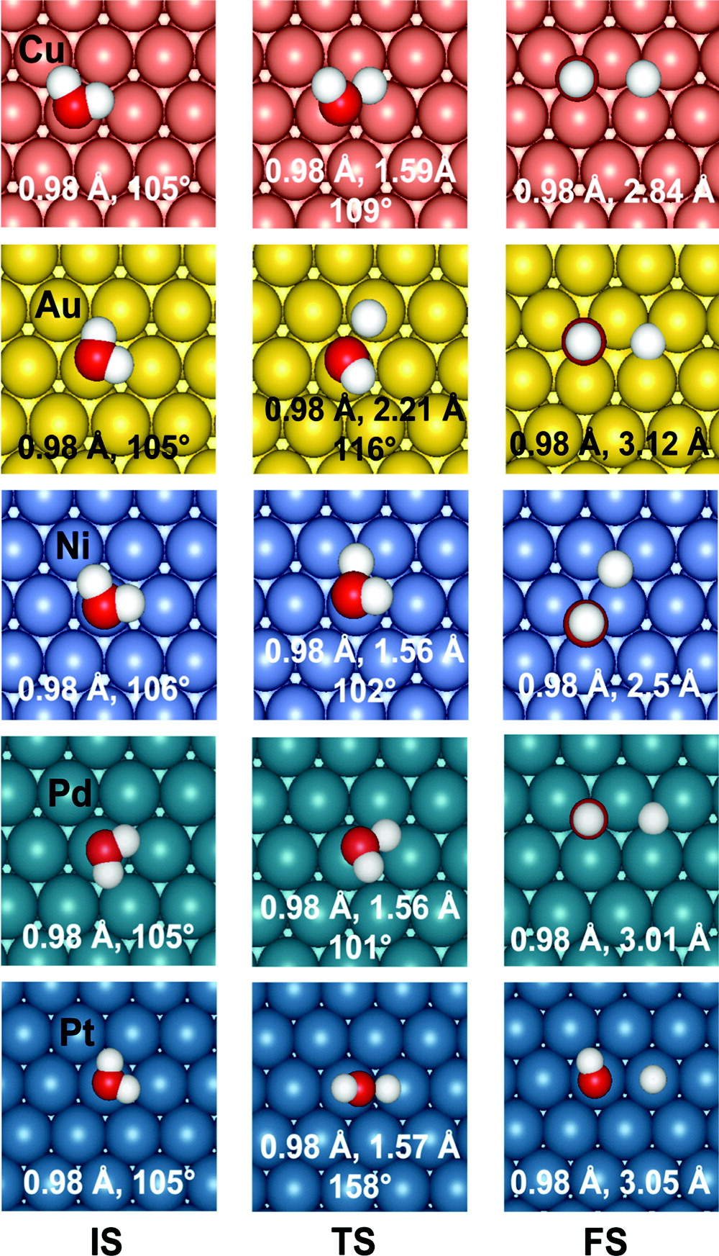
Locating Transition States Using DFT
Common techniques:
Nudged elastic band (NEB)
Climbing image nudged elastic band (CINEB)
Dimer
Vibrational analysis of transition state species yield one imaginary frequency
Initial State
Transition State
Final State
Energy
[1]
Reaction Coordinate
[1] Phatak, Abhijit A., et al. The Journal of Physical Chemistry C 113.17 (2009): 7269-7276.

Slide 18
Using Statistical Mechanics for Property Conversion
Statistical Mechanics
Useful DFT Properties
Bond lengths
Electronic energies
Vibrational frequencies
Coverage effects
MKM Inputs
Enthalpy (H)
Entropy (S)
Activation Energies (E_{A})
Preexponential factors (A)
Equilibrium constants (K_{eq})

Slide 19
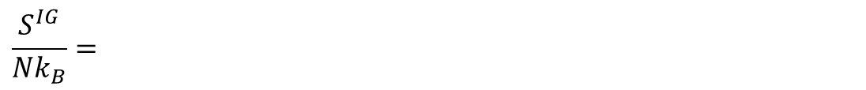
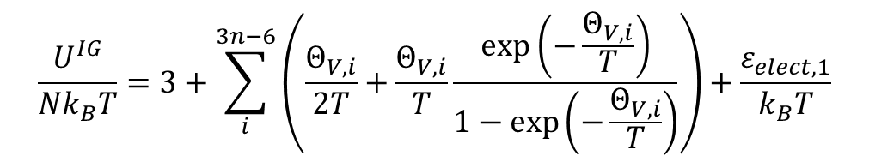
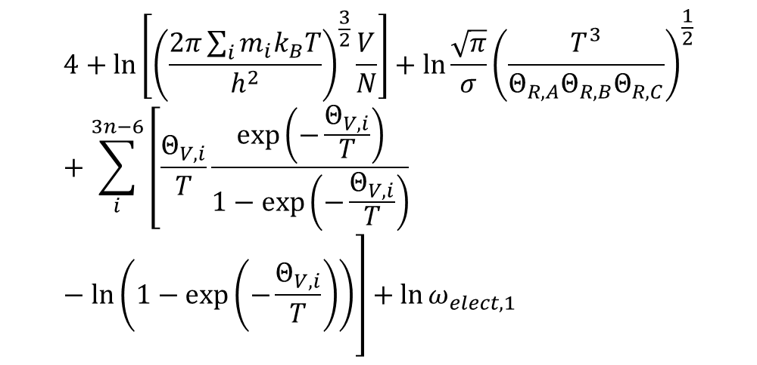
Statistical Mechanical Equations are Tedious and Error Prone
Statistical Mechanics
$$\frac{U^{IG}}{{Nk}_{B}T}=3+\sum_{i}^{3n−6}{\left(\frac{Θ_{V,i}}{2T}+\frac{Θ_{V,i}}{T}\frac{exp\left(−\frac{Θ_{V,i}}{T}\right)}{1−\exp\left(−\frac{Θ_{V,i}}{T}\right)}\right)}+\frac{ε_{elect,1}}{k_{B}T}$$
$$4+\ln\left[{\left(\frac{2π\sum_{i}{m_{i}k_{B}T}}{h^{2}}\right)}^{\frac{3}{2}}\frac{V}{N}\right]+\ln{\frac{\sqrt{π}}{σ}}{\left(\frac{T^{3}}{Θ_{R,A}Θ_{R,B}Θ_{R,C}}\right)}^{\frac{1}{2}}+\sum_{i}^{3n−6}{\left[\frac{Θ_{V,i}}{T}\frac{\exp\left(−\frac{Θ_{V,i}}{T}\right)}{1−\exp\left(−\frac{Θ_{V,i}}{T}\right)} −\ln\left(1−\exp\left(−\frac{Θ_{V,i}}{T}\right)\right)\right]+\ln{ω_{elect,1}}}$$
$$\frac{S^{IG}}{Nk_{B}}=$$

Slide 20
Statistical Mechanical Equations are Tedious and Error Prone
Statistical Mechanics
$$\frac{U^{IG}}{{Nk}_{B}T}=3+\sum_{i}^{3n−6}{\left(\frac{Θ_{V,i}}{2T}+\frac{Θ_{V,i}}{T}\frac{exp\left(−\frac{Θ_{V,i}}{T}\right)}{1−\exp\left(−\frac{Θ_{V,i}}{T}\right)}\right)}+\frac{ε_{elect,1}}{k_{B}T}$$
$$4+\ln\left[{\left(\frac{2π\sum_{i}{m_{i}k_{B}T}}{h^{2}}\right)}^{\frac{3}{2}}\frac{V}{N}\right]+\ln{\frac{\sqrt{π}}{σ}}{\left(\frac{T^{3}}{Θ_{R,A}Θ_{R,B}Θ_{R,C}}\right)}^{\frac{1}{2}}+\sum_{i}^{3n−6}{\left[\frac{Θ_{V,i}}{T}\frac{\exp\left(−\frac{Θ_{V,i}}{T}\right)}{1−\exp\left(−\frac{Θ_{V,i}}{T}\right)} −\ln\left(1−\exp\left(−\frac{Θ_{V,i}}{T}\right)\right)\right]+\ln{ω_{elect,1}}}$$
U_IG = get_U(T)
S_IG = get_S(T)
$$\frac{S^{IG}}{Nk_{B}}=$$

Slide 21
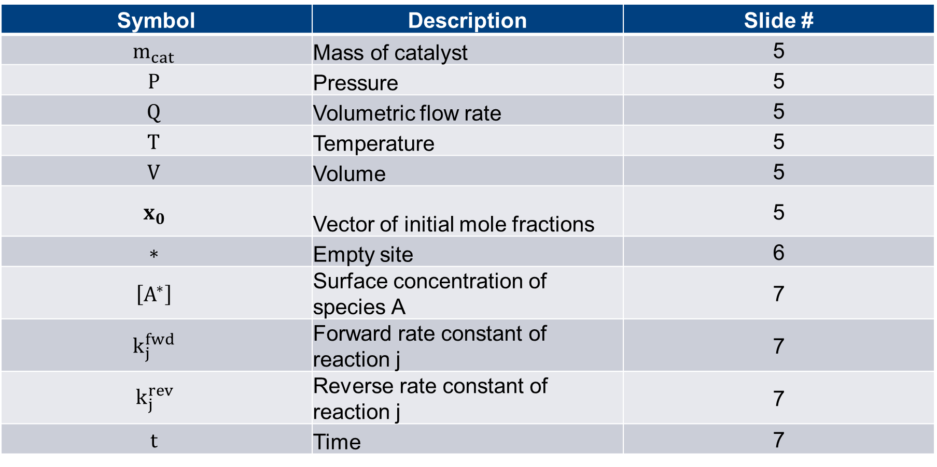
Symbol Reference Sheet
Symbol | Description | Slide #
$$m_{cat}$$ | Mass of catalyst | 5
$$P$$ | Pressure | 5
$$Q$$ | Volumetric flow rate | 5
$$T$$ | Temperature | 5
$$V$$ | Volume | 5
$$x_{0}$$ | Vector of initial mole fractions | 5
$$∗$$ | Empty site | 6
$$\left[A^{∗}\right]$$ | Surface concentration of species A | 7
$$k_{j}^{fwd}$$ | Forward rate constant of reaction j | 7
$$k_{j}^{rev}$$ | Reverse rate constant of reaction j | 7
$$t$$ | Time | 7

Slide 22
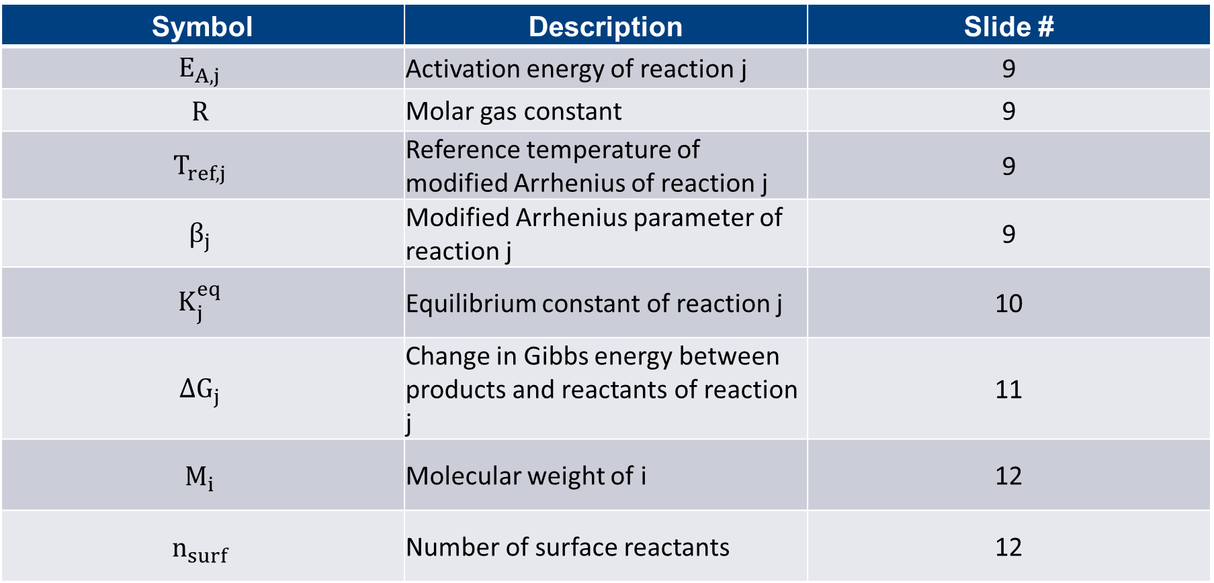
Symbol Reference Sheet
Symbol | Description | Slide #
$$E_{A,j}$$ | Activation energy of reaction j | 9
$$R$$ | Molar gas constant | 9
$$T_{ref,j}$$ | Reference temperature of modified Arrhenius of reaction j | 9
$$β_{j}$$ | Modified Arrhenius parameter of reaction j | 9
$$K_{j}^{eq}$$ | Equilibrium constant of reaction j | 10
$$ΔG_{j}$$ | Change in Gibbs energy between products and reactants of reaction j | 11
$$M_{i}$$ | Molecular weight of i | 12
$$n_{surf}$$ | Number of surface reactants | 12

Slide 23
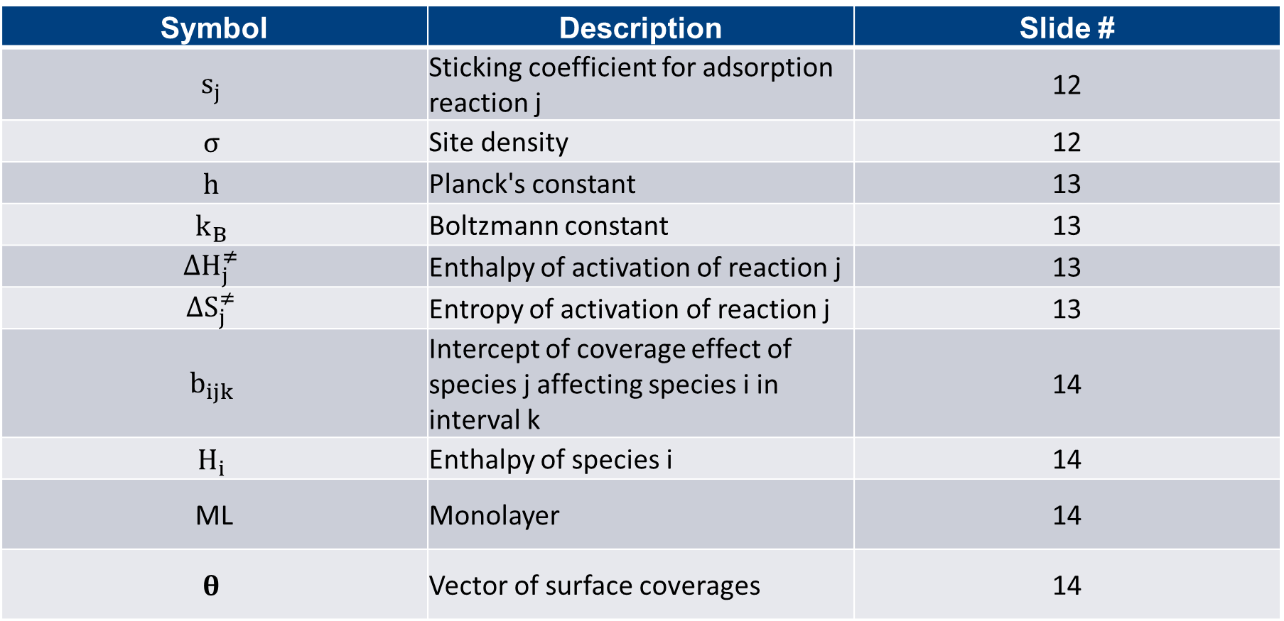
Symbol Reference Sheet
Symbol | Description | Slide #
$$s_{j}$$ | Sticking coefficient for adsorption reaction j | 12
$$σ$$ | Site density | 12
$$h$$ | Planck's constant | 13
$$k_{B}$$ | Boltzmann constant | 13
$$ΔH_{j}^{≠}$$ | Enthalpy of activation of reaction j | 13
$$ΔS_{j}^{≠}$$ | Entropy of activation of reaction j | 13
$$b_{ijk}$$ | Intercept of coverage effect of species j affecting species i in interval k | 14
$$H_{i}$$ | Enthalpy of species i | 14
ML | Monolayer | 14
$$θ$$ | Vector of surface coverages | 14

Slide 24
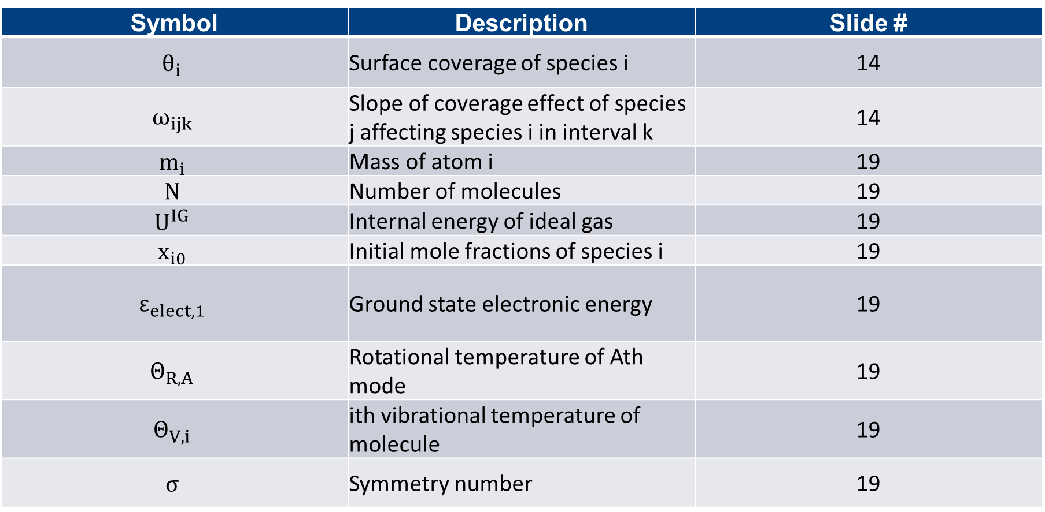
Symbol Reference Sheet
Symbol | Description | Slide #
$$θ_{i}$$ | Surface coverage of species i | 14
$$ω_{ijk}$$ | Slope of coverage effect of species j affecting species i in interval k | 14
$$m_{i}$$ | Mass of atom i | 19
$$N$$ | Number of molecules | 19
$$U^{IG}$$ | Internal energy of ideal gas | 19
$$x_{i0}$$ | Initial mole fractions of species i | 19
$$ε_{elect,1}$$ | Ground state electronic energy | 19
$$Θ_{R,A}$$ | Rotational temperature of Ath mode | 19
$$Θ_{V,i}$$ | ith vibrational temperature of molecule | 19
$$σ$$ | Symmetry number | 19

